Slide 1
Factor Analysis Theory and Interpretation

Slide 2
What is Factor Analysis?
A way to group items in a survey
Acts as your validity test
See how data “hangs together”

Slide 3
What is an item, anyway?
Question on a survey
Column in your data

Slide 4
Types of Factor Analysis
Exploratory (EFA)
Confirmatory (CFA)
First time
You’ll learn here
Been done before
You won’t learn

Slide 5
Assumptions of Exploratory Factor Analysis
Sample size: 300 rows of data
Absence of Multicollinearity:
No correlations > .9 between columns
Examine determinants
Some Relationship between Items
Bartlett’s test

Slide 6
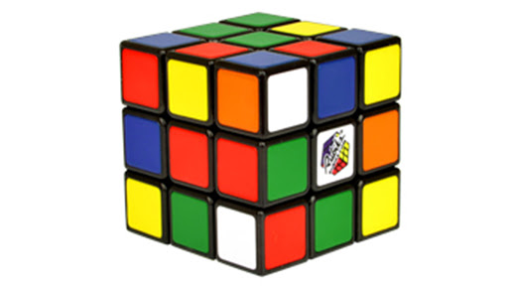
What is Factor Rotation?
A way to mathematically “shake up” your data so that interesting things fall out!
Behind the scenes, your data gets graphed and ends up as points on a graph. These points can be spun around in various ways to help interpret findings

Slide 7
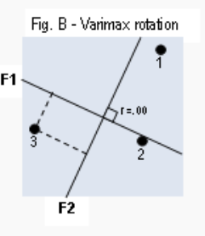
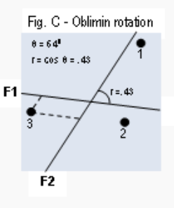
Types of Factor Rotation
Orthogonal
Oblique
When your data isn’t theoretically related
Rotate 90 degrees
AKA varimax, quartimax
When your data is theoretically related
Rotate < 90 degrees
AKA oblimin, promax

Slide 8
Running the Analysis

Slide 9
When you run factor analysis, try variations…
Number of factors
Type of rotation
Eliminating items

Slide 10
Number of Factors
Look at the SS loadings > 1 for a start
Examine scree plot
Examine residuals (should be > 50%)

Slide 11
Type of Rotation
Varimax
Oblimin
Try both at least!

Slide 12
Eliminate Items that…
Were suspect in your assumptions section
Didn’t correlate well <.3 with multiple items
Correlated too much > .9 with multiple items
Don’t load on a factor
Isn’t .3 or greater
Have negative loadings on a factor

Slide 13
Interpreting Factor Analysis Results

Slide 14
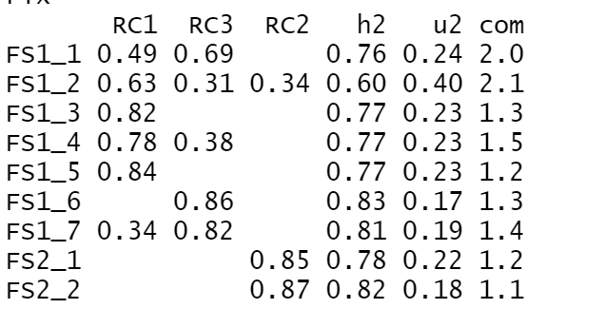
Each RC is a factor – group of similar items Anything > .3 loads on that factor Pick the highest loading if it is on more than one

Slide 15
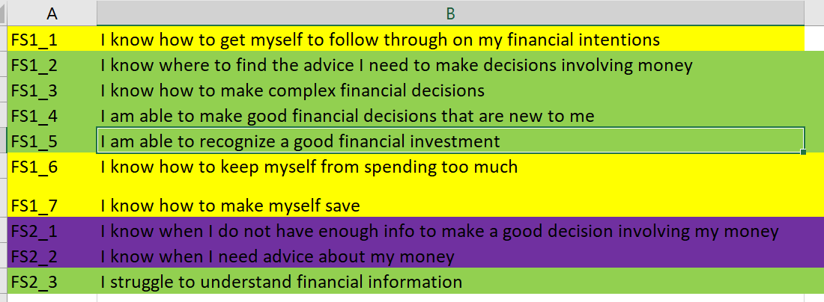
Use the Codebook to Determine Meaning!

Slide 16
Real-Life Use Case for Factor Analysis
Survey items from chronic pain patients on a new way to screen for fear-avoidance of pain
Wanted to see if there were subtypes of fear-avoidance so we could better address patients
Items fell into fear, avoidance, and depression categories that then became subscales

Slide 17
Questions?

